Slide 1
10/08/16

Slide 2
in the papers published/submitted so far:
Iliadis et al., ApJ 831, 107 (2016)
Gomez et al., submitted to ApJ (2017)
all we did is to use an external table containing the results of a theoretical S-factor
calculation and to find the “scale factor” by which theory needs to be multiplied to
fit the data [there are other parameters for systematic uncertainties, outliers, etc.].
For the future, our goal is to estimate directly the parameters of the nuclear model;
this means that we cannot simply input an external table with the nuclear model
results. What needs to be done is to include the nuclear model as a function in JAGS,
to call this function directly during sampling, and to optimize the parameters.
The simplest nuclear model we can think of is a Breit-Wigner S-factor, with three
parameters: resonance energy, incoming width, outgoing width. A good example is
the ³H(d,n)⁴He reaction S-factor, shown in the next slide. This will be our next project.
However, before we get there it is interesting to perform a few tests using Lorentzian
functions [not exactly the same as Breit-Wigner, but more on that later], for which
we also have 3 parameters, but for which we do not need a new JAGS function

Slide 3
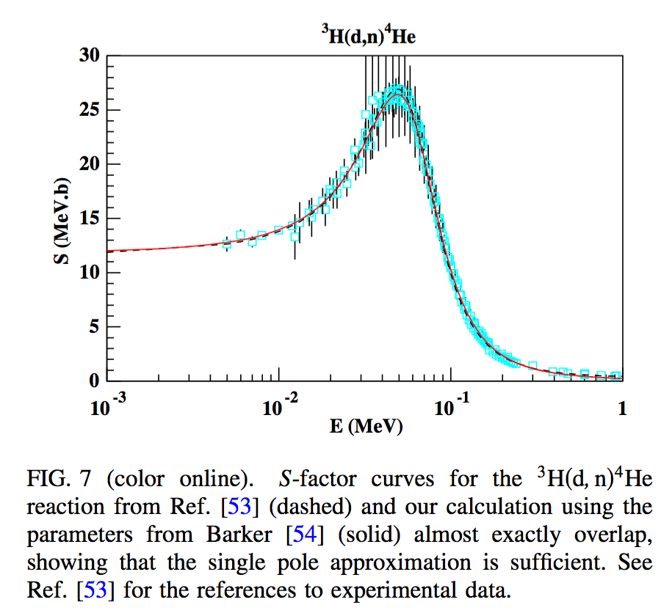
Coc et al., PRD 86, 043529 (2012)

Slide 4
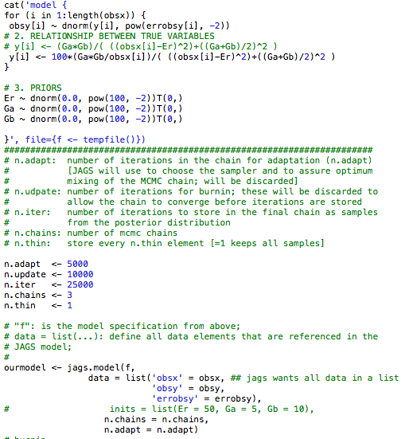
Bayesian analysis of a simple Lorentzian
SKIP
notice 1/E in
expression
no initial
values

Slide 5
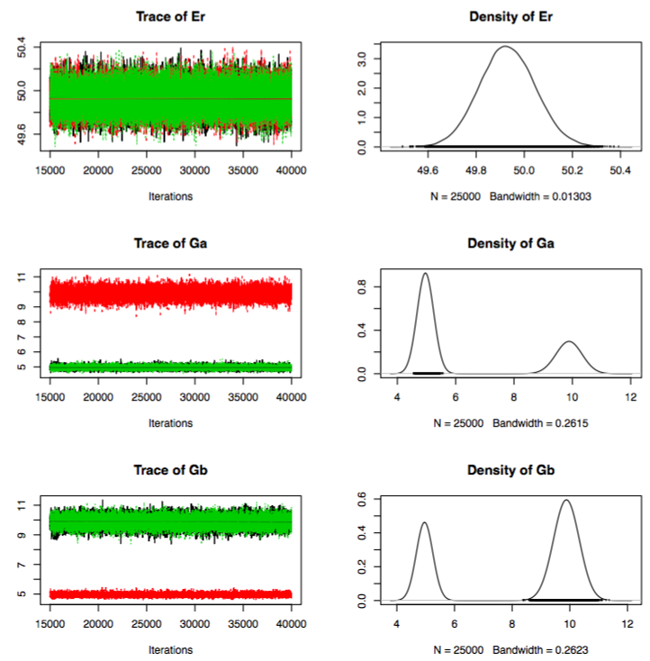
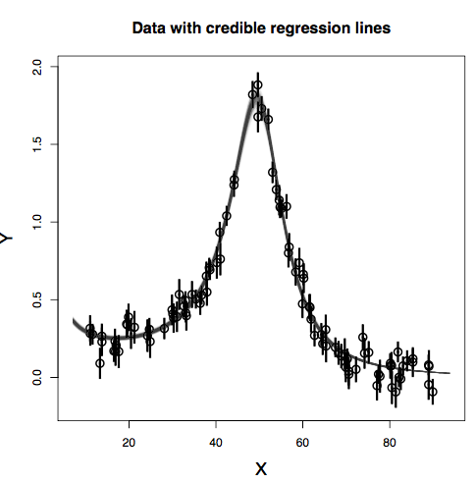
SKIP
double peaked
posterior
sometimes, double peaked
structure disappears, depending
on random number seed

Slide 6
SKIP
what happens if I remove this
truncation [i.e., allowing for negative
resonance energies]?

Slide 7
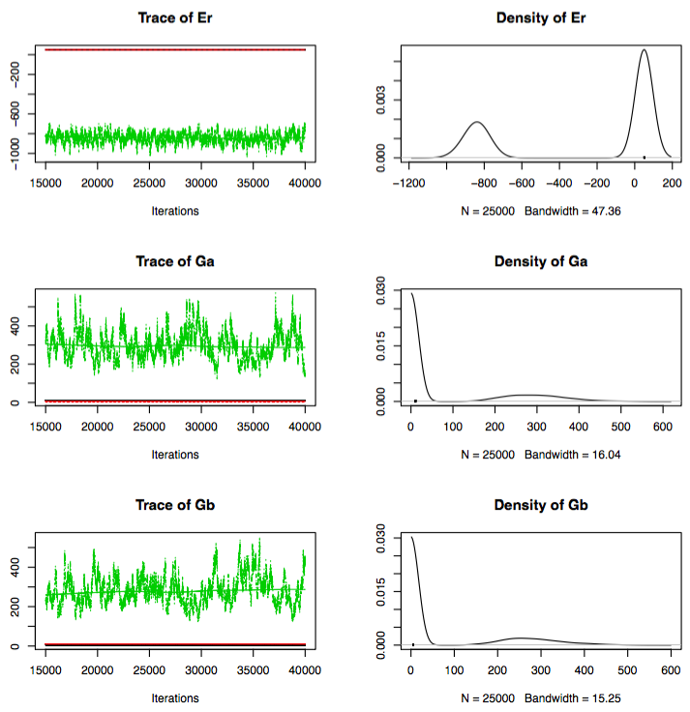
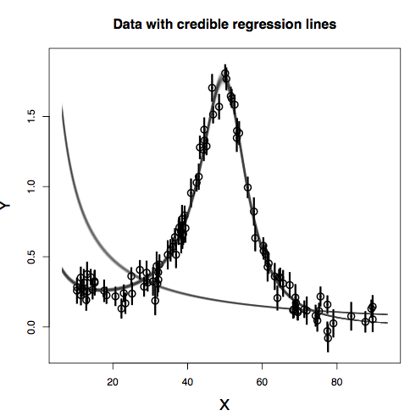
then sometimes, depending on the random number seed, we obtain this:
SKIP

Slide 8
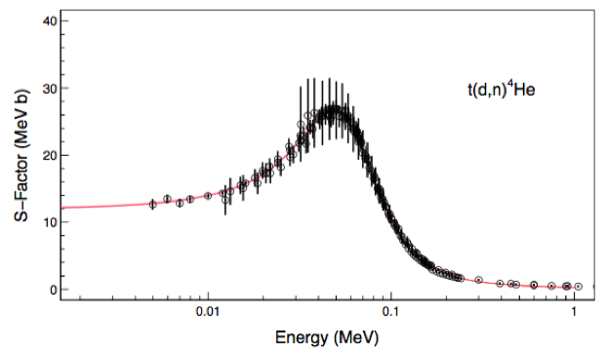
SKIP
A first stab at ³H(d,n)⁴He
note: data are very crude [we do not have separate estimates for statistical and
systematic uncertainties]; here we assume entire uncertainty is statistical;
in any case, we should be able to fit the data….
Notes:
same calculation as next few pages

Slide 9
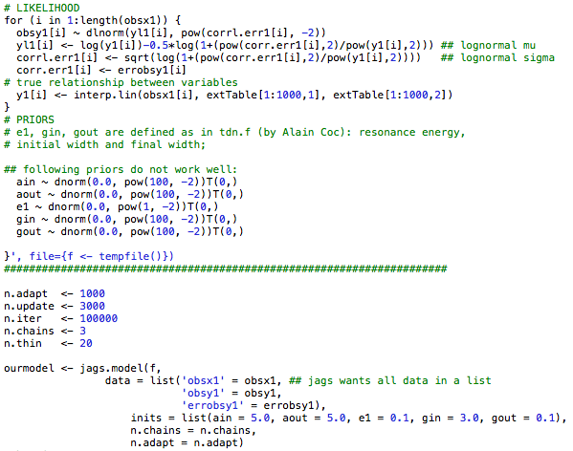
SKIP
notice
thinning
without starting
values that are close,
the fit is no good

Slide 10
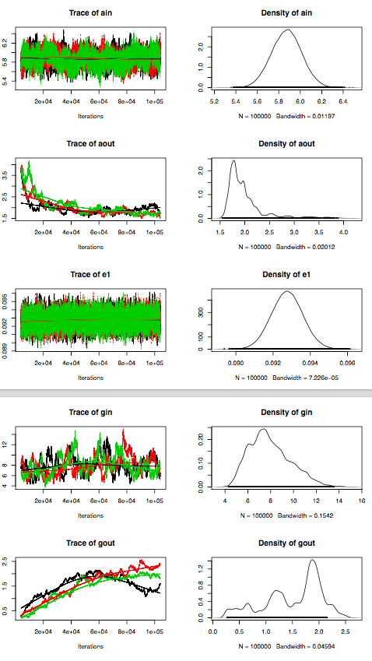
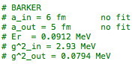
SKIP

Slide 11
11/10/16

Slide 12
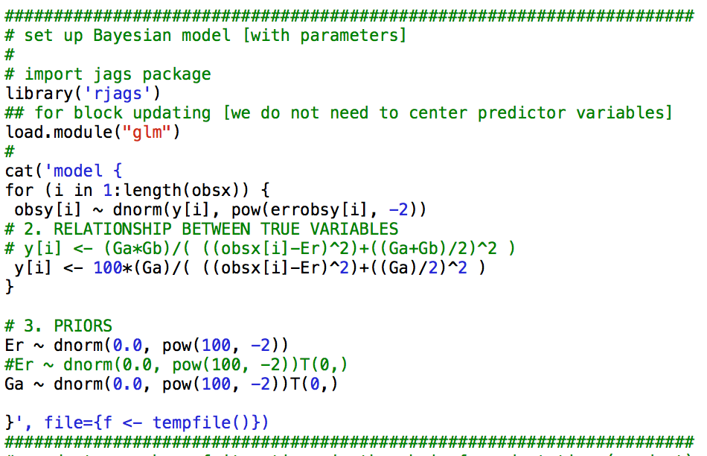
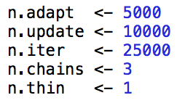
Lorentzian with ONE partial width
energy not
truncated
broad priors

Slide 13
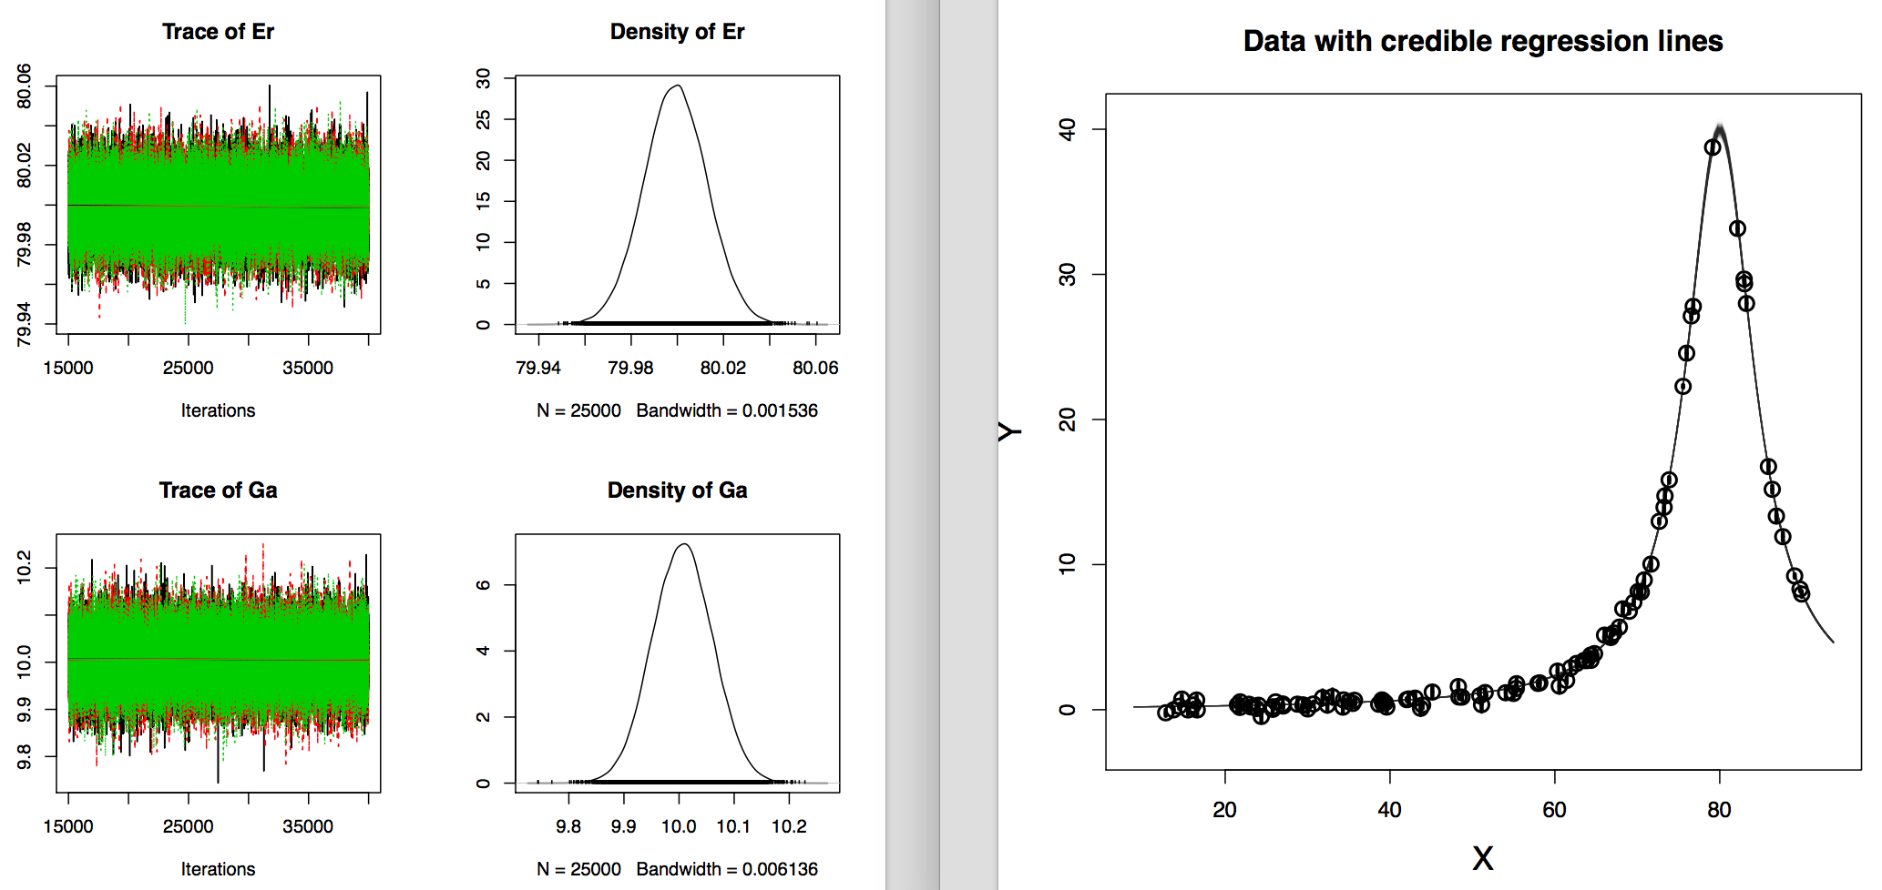
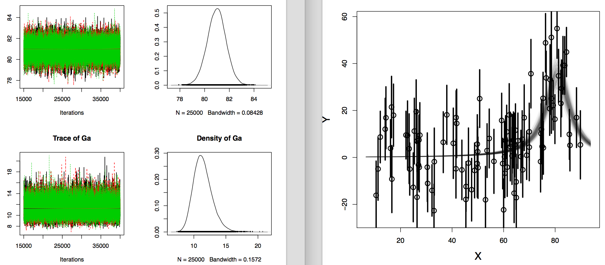
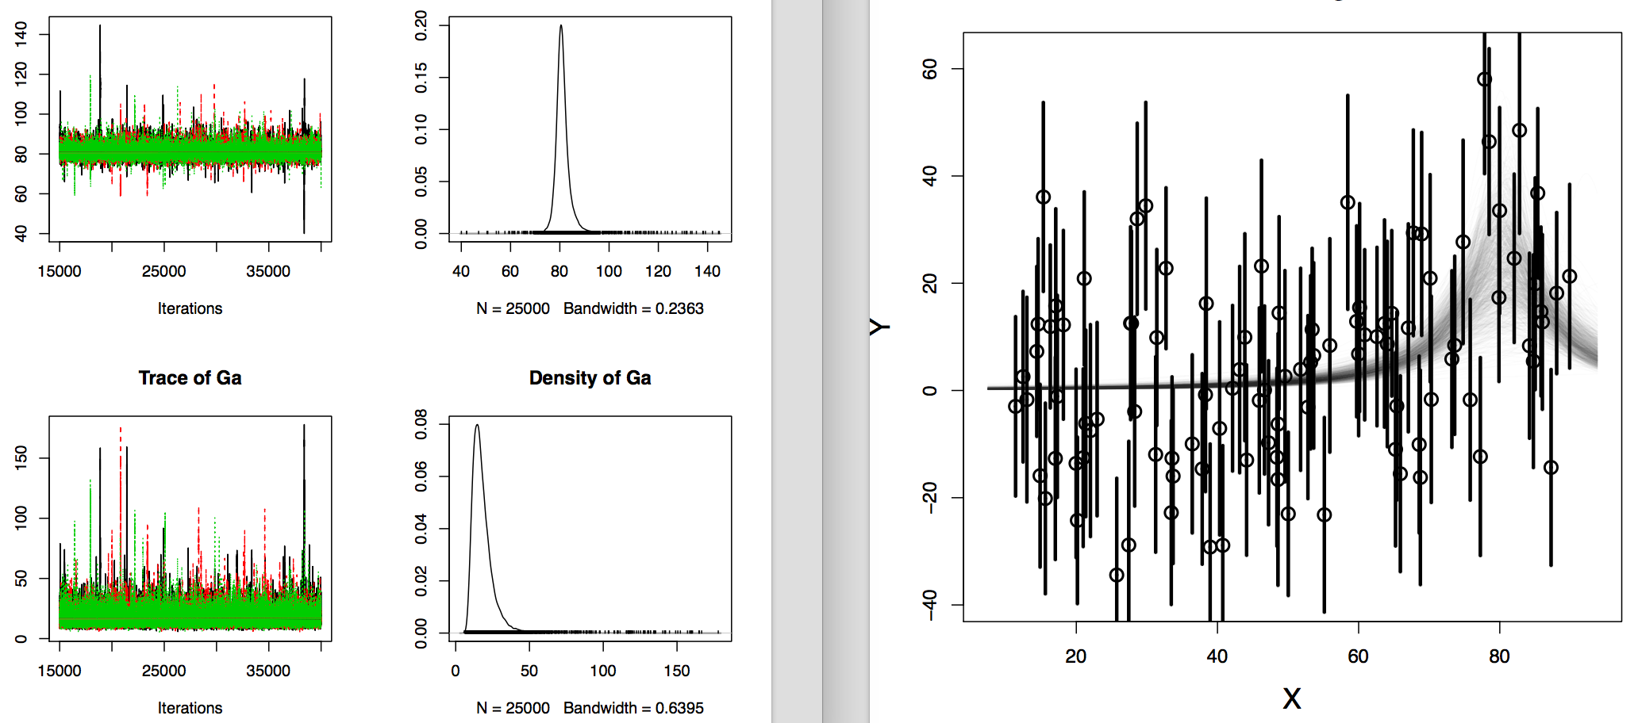
data generated with:
Er=80, Ga=10
…larger error bars...

Slide 14
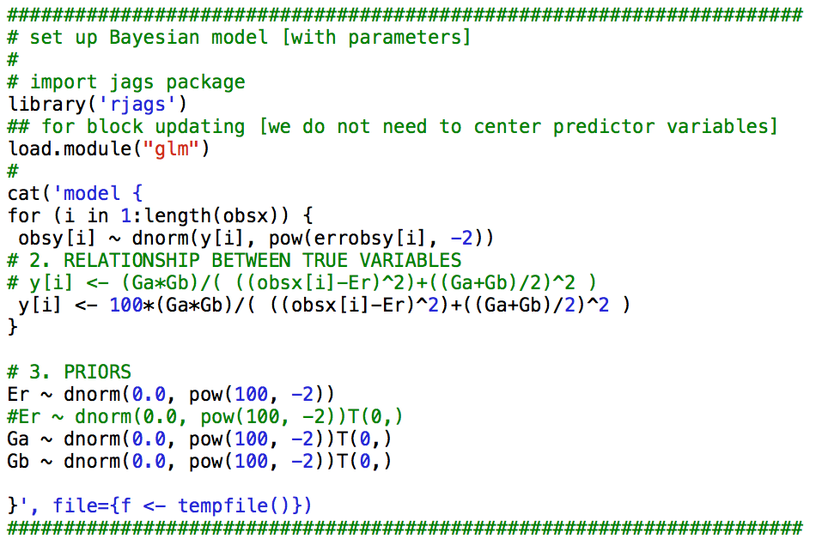
notice degeneracy
Lorentzian with TWO partial widths
***broad Gaussian priors***

Slide 15
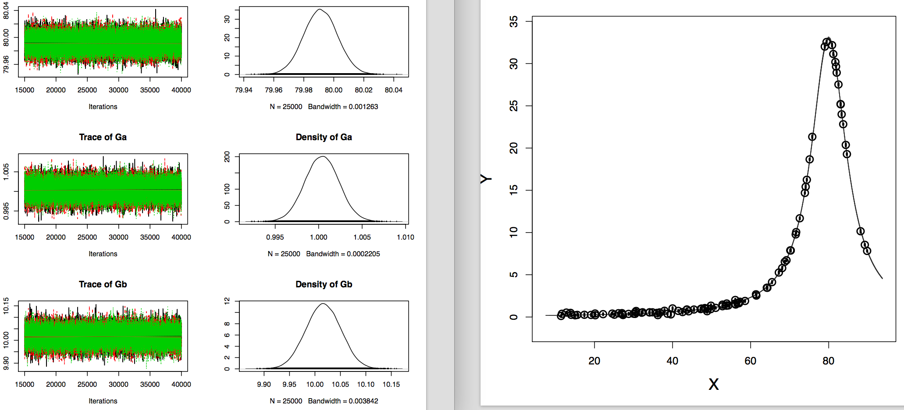
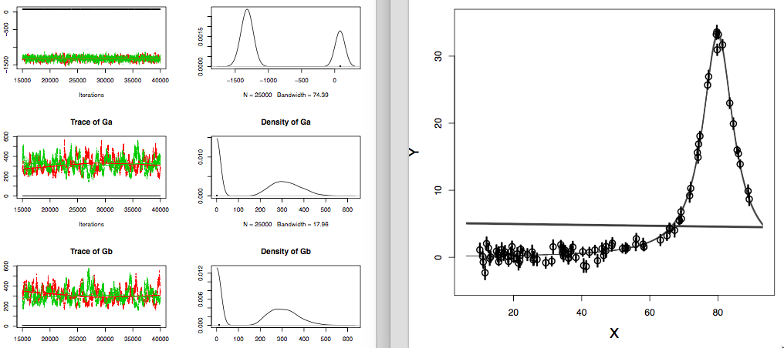
small uncertainties
data generated with:
Er=80, Ga=1, Gb=10
sometimes, not always, depending on random number seed….
the posterior peaks are all over
the place; the problem is that the
system keeps switching between
two states: one where Ga=1, Gb=10,
and another where Ga=10, Gb=1;
since both solutions are just as valid
numerically, the system can’t decide
which one to converge to, and hence
it gets stuck…
??

Slide 16
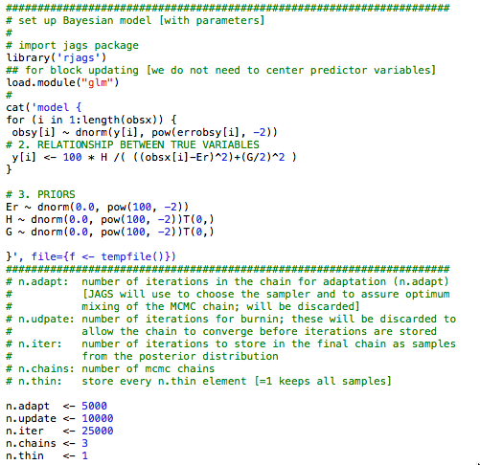
change in variables to break degeneracy:

Slide 17
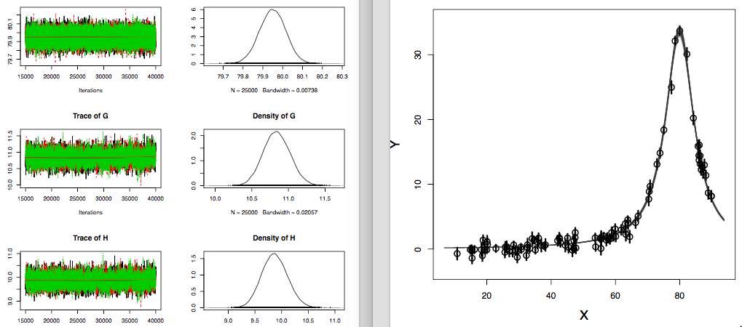
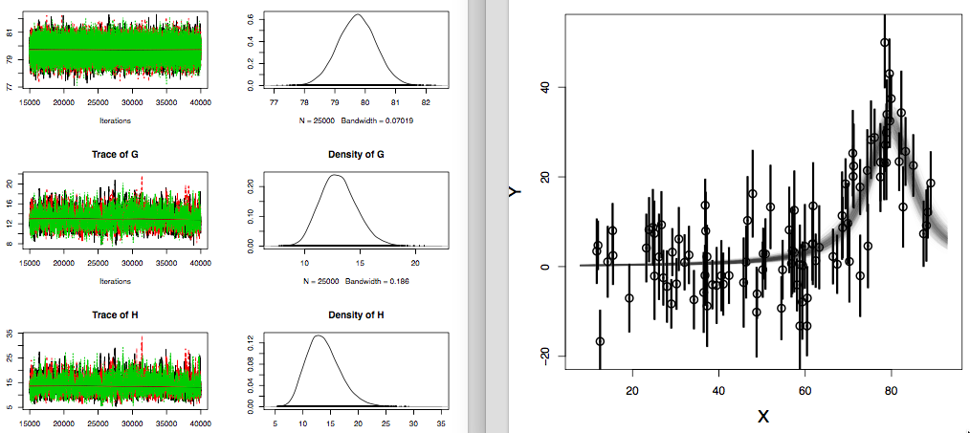
repeated attempts give reasonable results

Slide 18
but that is not a solution in the actual data analysis, when penetration factors, P_{i}, need
to be calculated using Coulomb wave functions;
for example, for ³H(d,n)⁴He, we got:
Γ_{d} = 2P_{d}γ²_{d}
Γ_{n} = 2P_{d}γ²_{d}
and the model parameters are the reduced widths, γ², not the partial widths, Γ_{i}
the denominator can be written as a product 4P_{d}P_{d}γ²_{d}γ²_{d}, and the product of reduced
widths can be redefined, but this is not possible for the denominator:
… + 0.25(2P_{d}γ²_{d}+2P_{d}γ²_{d})

Slide 19
01/10/17

Slide 20
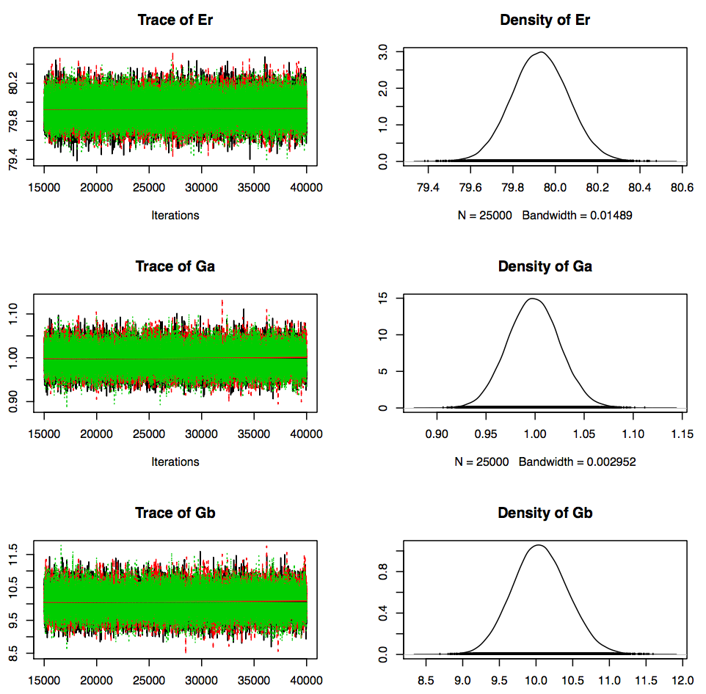
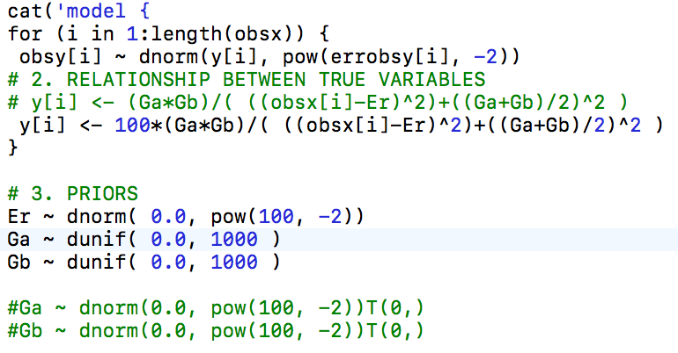
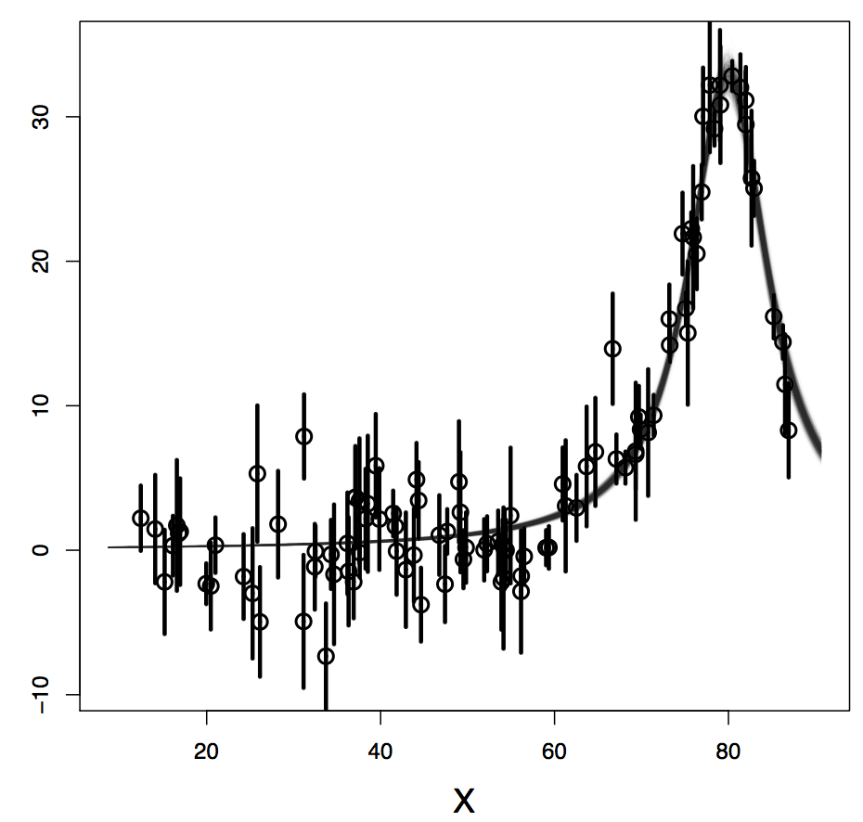
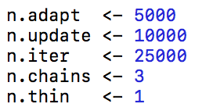
fresh start:
data generated with:
Er=80
Ga=1
Gb=10
Gaussian prior
for energy
now I get always good
results, even doing 10
runs in a row!
if I switch to broad
Gaussian priors, the
results are immediately
bad!
[no initial starting values]

Slide 21
do several runs for each condition below:
Er | Ga | Gb | priors for reduced widths | initial values | results: mixing | results: data fit
80 | 1 | 10 | uniform [1,1000] | no | good | good
80 | 1 | 10 | broad Gaussian | no | bad | bad
80 | 5 | 5 | uniform[1,1000] | no | bad | bad
80 | 4 | 6 | uniform[1,1000] | no | bad | bad
80 | 2 | 5 | uniform[1,1000] | no | good | good
80 | 2 | 4 | uniform[1,1000] | no | good | good
conclusion: good results are obtained with uniform priors for widths
and Ga and Gb that are not too similar

Slide 22
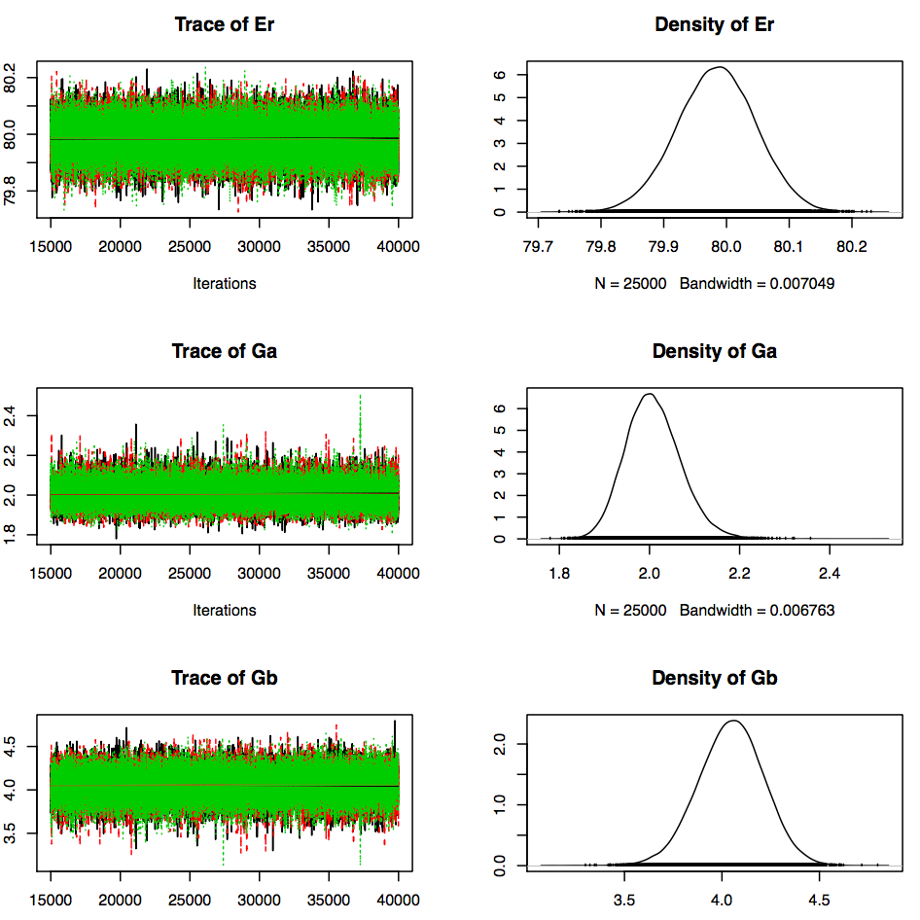
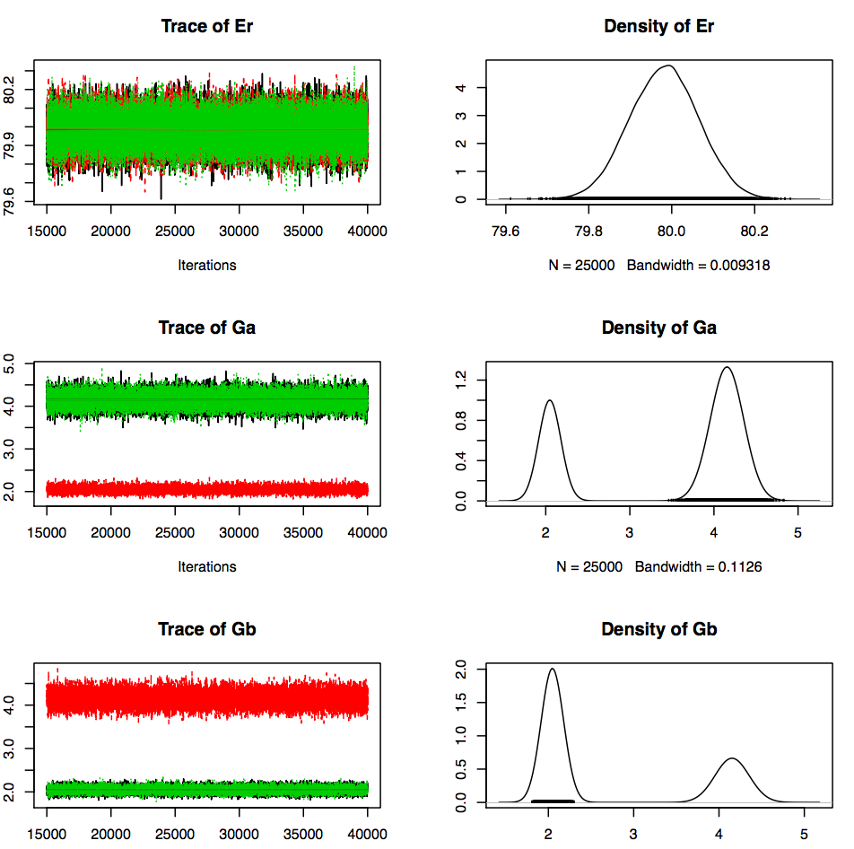
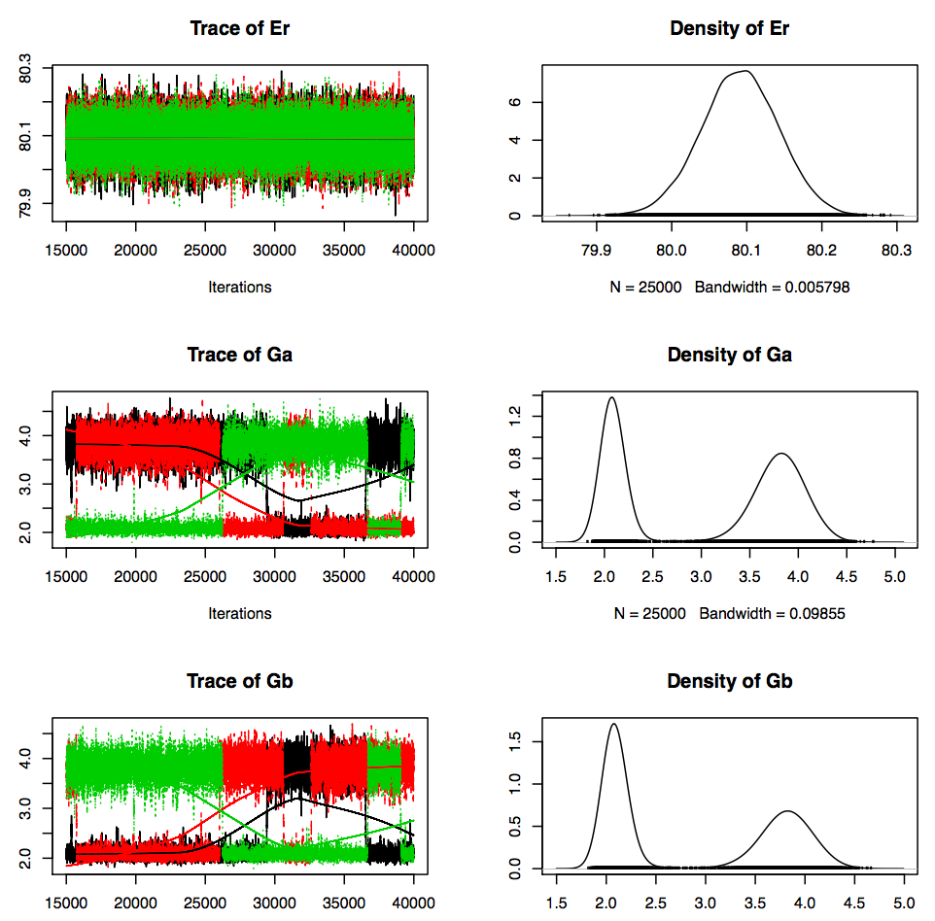
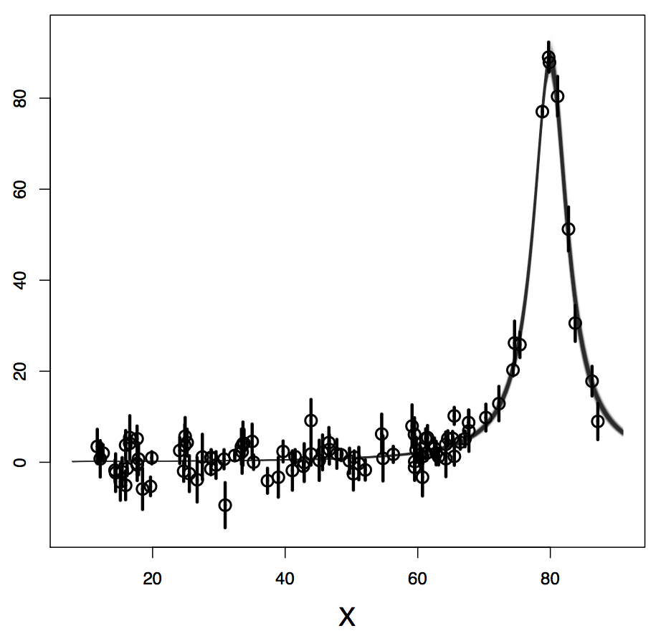
all of the following good results were obtained with uniform priors and Ga=2, Gb=4
[Ga and Gb not too different]:
given chain jumps
from first solution
to second one, but
final fit looks good;
notice the broader
posteriors
best result you
can hope for
different chains converge
to different values, but
final fit looks good

Slide 23
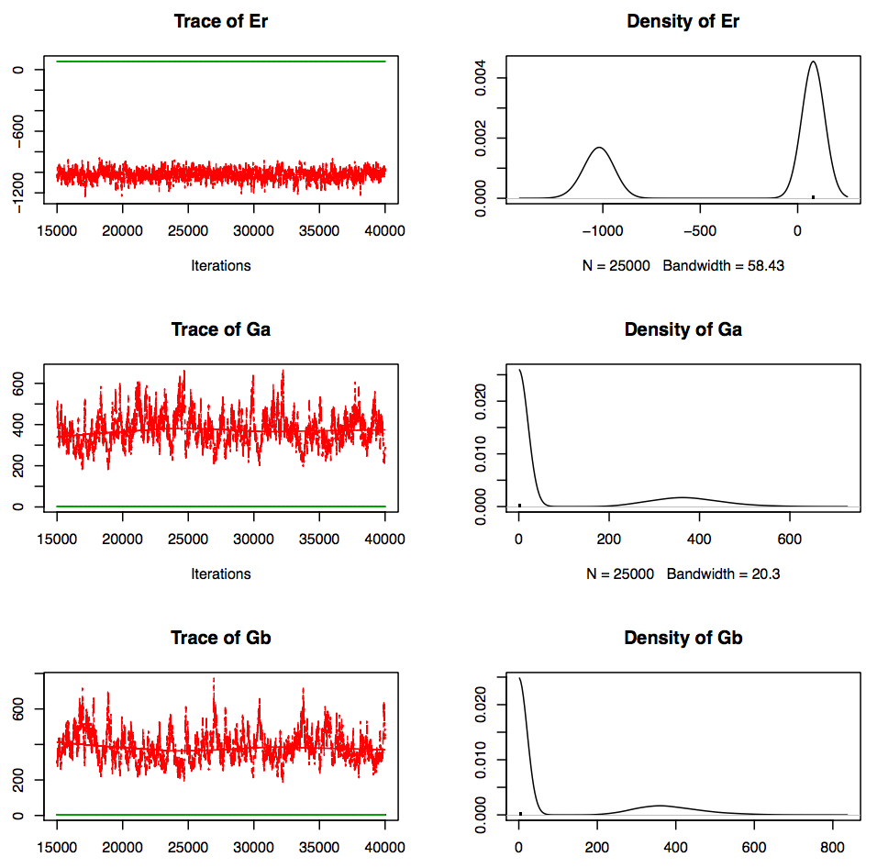
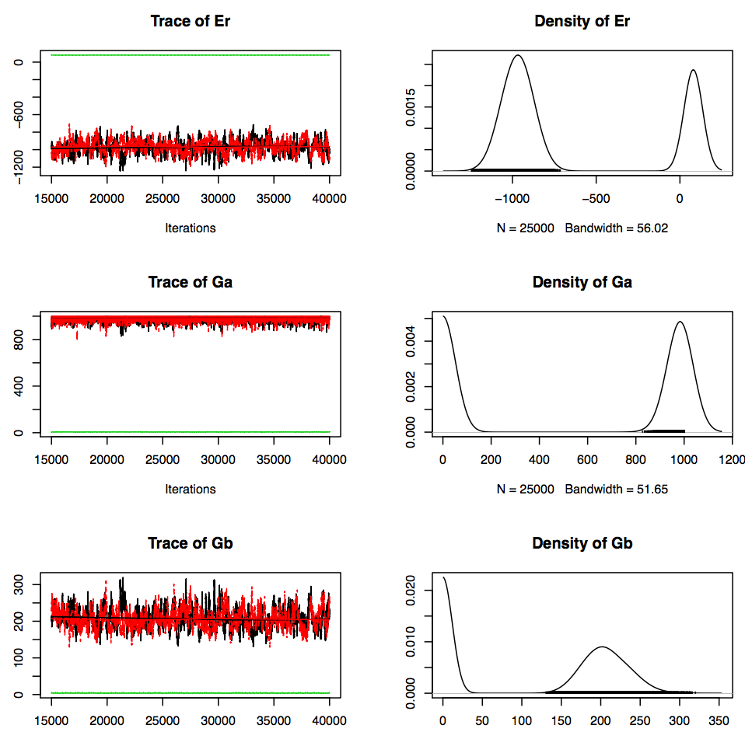
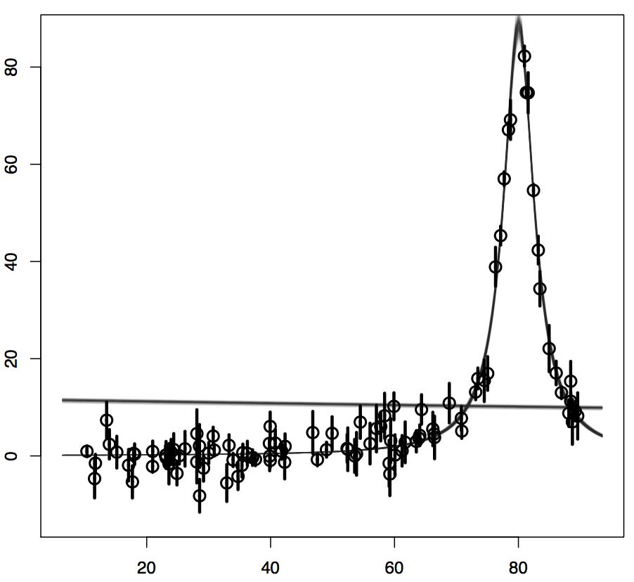
bad results look like this:
notice that now there
are two solutions for the
resonance energy!
Ga=2, Gb=4; Gaussian priors
Ga=4, Gb=6; uniform priors
sometimes, depending on
the random number seed,
I even get good results for
these conditions

Slide 24
or looked in another way, assuming uniform priors:
ratio of 1
Ga/Gb
or
Gb/Ga
good results;
all chains converge
to same values
good results;
different chains
or given chain
converge(s) to
one of two solutions
bad results; MCMC
cannot find the
resonance energy
and fit is completely
off

Slide 25
what can help when the partial widths are similar:
if you see a peak in the cross section at positive energy, there is no
good reason to allow the energy prior to become negative
[philosophical argument: what is a prior? “before seeing the data”?
or “before performing the data analysis”?]
we used a Gaussian prior for the energy; a uniform prior may be better?!
for real data: we know that the priors for reduced widths must be
Porter-Thomas distributed [see our earlier work: Longland et al, NPA 841,
1 (2010); Pogrebnyak et al., PRC 88, 015808 (2013)]
we could use initial starting values for the MCMC
next: see if any of this helps when Ga and Gb are similar in magnitude

Slide 26
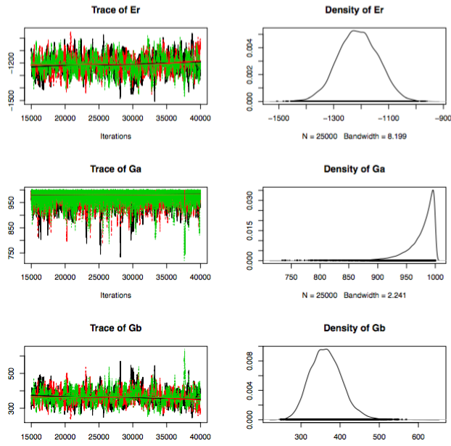
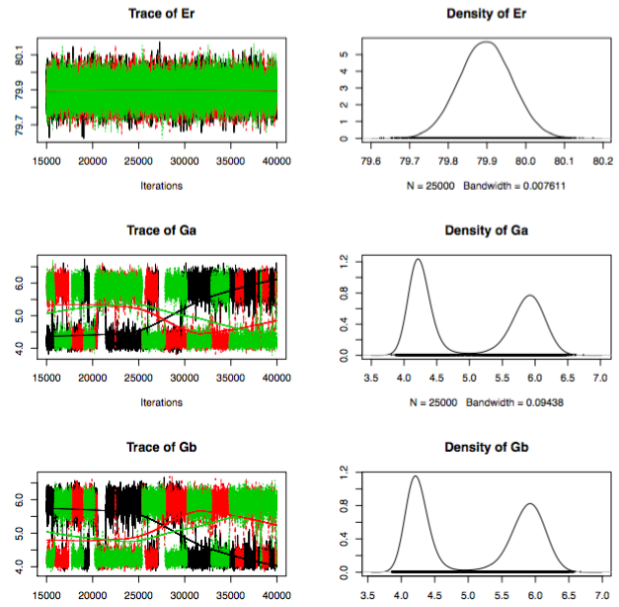
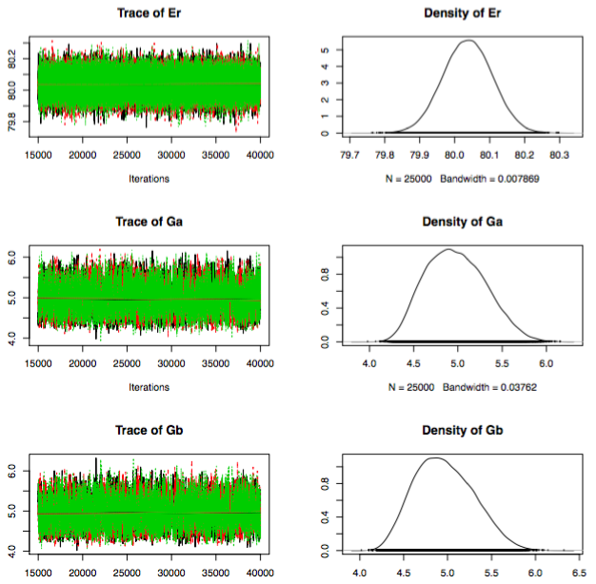
let’s do a few tests; we will stay with Ga=4.5 and Gb=5.5; uniform priors for partial widths
[no initial starting values]
Gaussian prior for Er
uniform prior Er ~ dunif(0, 1000)
garbage
each given chain flip-flops
between partial width solutions,
but fit looks good; to be fair,
we are restricting Er to positive
values with this prior
these are “single-value
solutions”, but notice
that the peaks are much
wider than in solution on
left

Slide 27
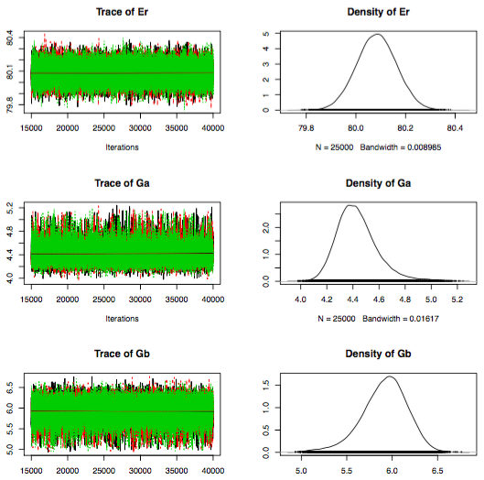
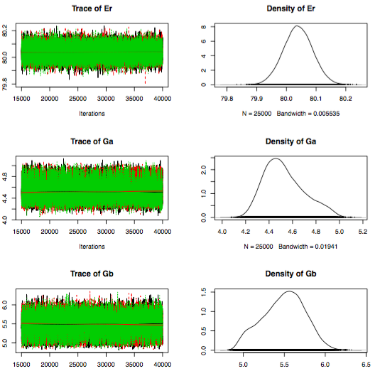
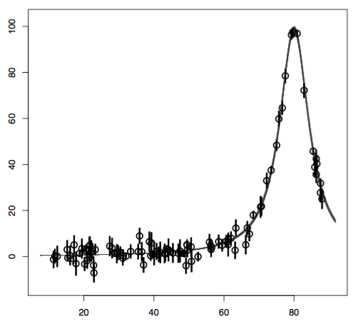
let’s do more tests; we will stay with: Ga=4.5, Gb=5.5; uniform priors for all parameters
[allowing for positive values only]; no initial starting values
but now we will break degeneracy in partial widths using the prior construct:
Ga ~ dunif( 0.0, 500.0 )
Gb ~ dunif( Ga, 1000.0 )
did a series of runs,
results are stable…
reduced width posteriors are
much narrower than before!
[the displayed scale is different]

Slide 28
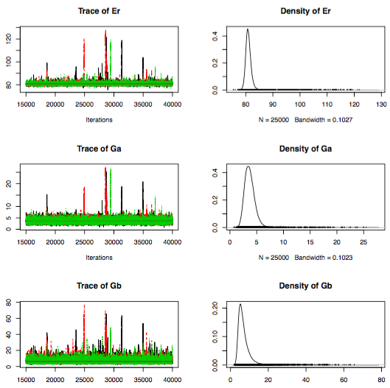
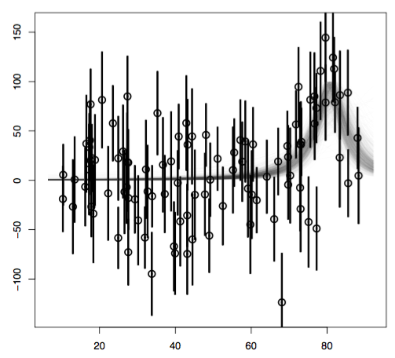
let’s be adventerous, and increase the error bars:

Slide 29
next, try to fit ³H(d,n)⁴He data using what we have learned in these tests:
RESONANCE ENERGY
restrict to positive values [since we see that the S-factor peaks at E>0]
use a uniform positive or truncated Gaussian prior
REDUCED WIDTHS
try Porter-Thomas distributions for reduced width priors
to break degeneracy, chose in the prior construct one width always
larger than the other one [see earlier]
- use initial starting values for the MCMC

